Slide 1

Sentiment Analysis of Tweets
- Emotional Intelligence for the twitter Feed
CSE 6363 : Machine Leaning
Submitted By:
Sai Sruthi Renati - 1002152041
Spring 2025
Instructor: Jesus Gonzalez

Slide 2

Project Overview:
Objective:​
To perform multi-class sentiment classification on Twitter data using three architectures — a traditional machine learning model (SVM), a recurrent deep learning model (RNN-BiLSTM), and a transformer-based hybrid model (DistilBERT-BiLSTM).
The objective is to evaluate and compare their performance in terms of classification accuracy, model generalization, contextual representation capability, and training efficiency.
Challenges:​
Short context window with potential sarcasm and ambiguity.
Need for models that can handle both semantic and sequential dependencies in text.
short, noisy, and often sarcastic language.
Dataset :​We took dataset from Kaggle. It has around 69k data

Slide 3
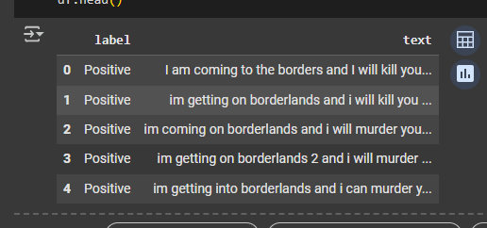
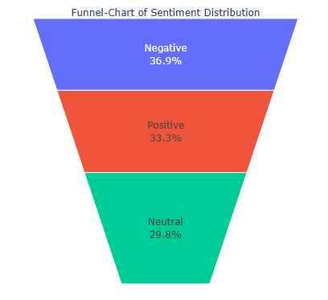
Dataset preview & Visualization:
Used wordCloud to visualize the positive,
negative and most frequent words.
By barplot and funnel plot we have shown that
data is balanced for all the labels .

Slide 4
Pre-Processing:
STEPS | DESCRIPTION
Class labeled | Positive, Negative and Neutral – encoded to 2, 0 and 1.
Text Cleaning | Removed URLs, Mentions(@user),Special characters, numbers
Lowercasing | Converted all text to lower case
Stopword Removal | Used NLTK’s English stopword list to filter out informative and common words
Lemmatization | Used wordNet to convert words to base/root words
Label Encoding | In SVM Used (bag of models), Applied LabelEncoder() to convert textual labels to numerical classes in RNN-LSTM and DistilBert-BILSTM
Tokenization | Regular for SVM, Regular tokenization and padding upto Max_length = 50), used DistilBert Tokenizer from hugging Face(Max length=64, padding and truncating)
Train/Val/Test Split | 70% Train, 15% Validation, 15% Test using stratified sampling for label balance

Slide 5
Support Vector Machine(SVM):
As it’s a early text classification model which paired with TF-IDF vectorization, performs well with high- dimensional, sparse features sets. we got
Train Accuracy :87 %
Validation Accuracy : 82%
Test Accuracy :82%
There are major Limitations –
No sequential and Context awareness – Its not able to understand Good Vs not Good.
Manual Feature engineering – Relies on TF-IDF, its not a learned features
Struggles with noisy, short text – Tweets are informal and it has slang ad sarcasm.
To Over come these Limitations, We have studied the second paper where, Recurrent Neural Networks(RNNs) with BiLSTM used to design and capture temporal dependencies and learn features directly from data.

Slide 6
RNN – Bi LSTM:
STEPS | PROCESS | DESCRIPTION
Tokenizer + Padding | Tokenizer + pad_sequences to convert tweets into sequences of equal length (maxlen = 50) | All inputs are in same sequence for better training
Embedding Layer | Embedding(input_dim, output_dim=256) | Learns vector representations of words
BiLSTM Layer | Bidirectional(LSTM(128)) | Concepts from both directions
Dropout Layer | Dropout(0.3) | Prevent overfitting
Dense Layers | Fully connected layers for classification | Learns high-level patterns for sentiment detection
Activation Function | Relu | Great for intermediate feature extraction.
Output layer | SoftMax | Converts output to class probabilities
Loss & Optimizer | loss='sparse_categorical_crossentropy', optimizer='adam' | Effective and ideal for sentiment Adam- fast learning rate
EarlyStopping | Stops training when val_loss doesn’t improve for 10 epoch | Prevents overfitting, saves best weights

Slide 7
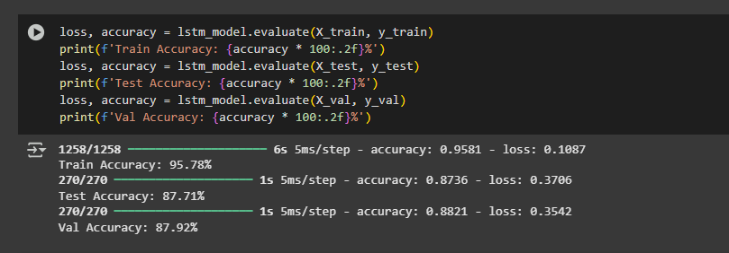
RNN – Bi LSTM:
ACCURACY OF TRAIN, VALDIATE AND TEST:
Train Accuracy – 95.78%
Validation Accuracy – 87.71%
Test Accuracy – 87.92%

Slide 8
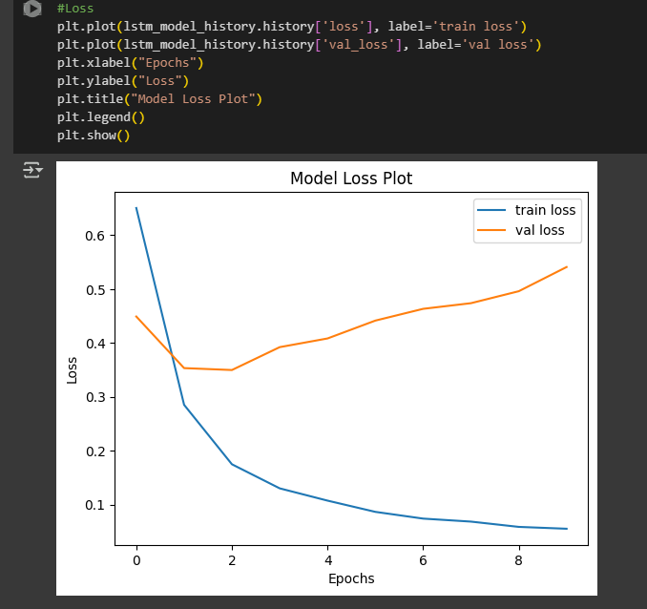
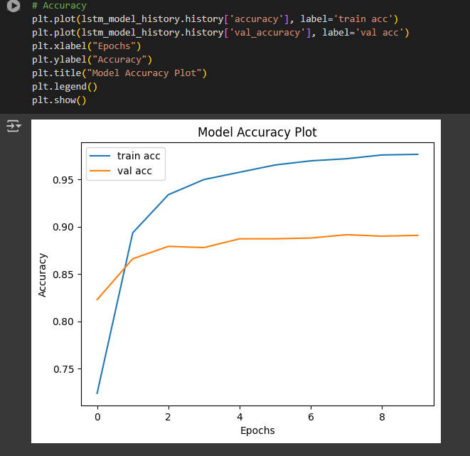
RNN – Bi LSTM:
Visual representation of LOSS and ACCURACY of train and validation(Epochs):

Slide 9
RNN – Bi LSTM:
Limitations :
No Pretrained Language - Starts from scratch, needs more training data to generalize.
Slower to Train - Learns both embeddings and sequence dependencies together from zero
Limited Semantic Awareness – Can not link the word happy and joyful.
Less Robust to Noise - Tweets often have slang, typos – RNN are not pretrained to handle.
To Over come these Limitations, We have studied the third paper where, BiLSTM improves sequence modeling, it still lacked semantic context and required more training data. DistilBERT-BiLSTM solves this by using pretrained embeddings from DistilBERT — giving the model deep language understanding from day one, and letting BiLSTM focus only on capturing sequence dynamics.

Slide 10
DistilBERT – BiLSTM:
STEPS | PROCESS | DESCRIPTION
Tokenizer (DistilBERT) | DistilBertTokenizer.from_pretrained | Uses Hugging Face tokenizer
Padding + Truncation | max_length=64, padding=True, truncation=True | Ensures uniform input size for batching
Pretrained BERT | "distilbert-base-uncased" | Fast, lightweight transformer with 97% performance of BERT
BiLSTM Layer | hidden_size=128, bidirectional=True | Captures patterns in both directions
Dropout Layer | Dropout(0.3) | Prevent overfitting
Output Layer | Linear(256, 3) | Outputs logits for 3 sentiment classes
Loss Function | CrossEntropyLoss() | Suitable for multi-class classification with integer labels
Optimizer | AdamW | Adaptive optimizer ideal for transformer fine-tuning

Slide 11
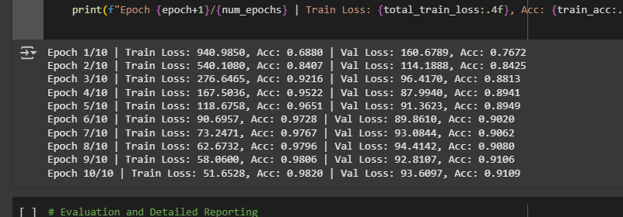
DistilBERT – BiLSTM:
For this Model as well we have used 10 Epochs to train and validate the model, as the model
is pretrained in the second epoch itself we got the huge increase in the accuracy and by third
epoch our accuracy is more then RNN-BILSTM which proves its faster.

Slide 12
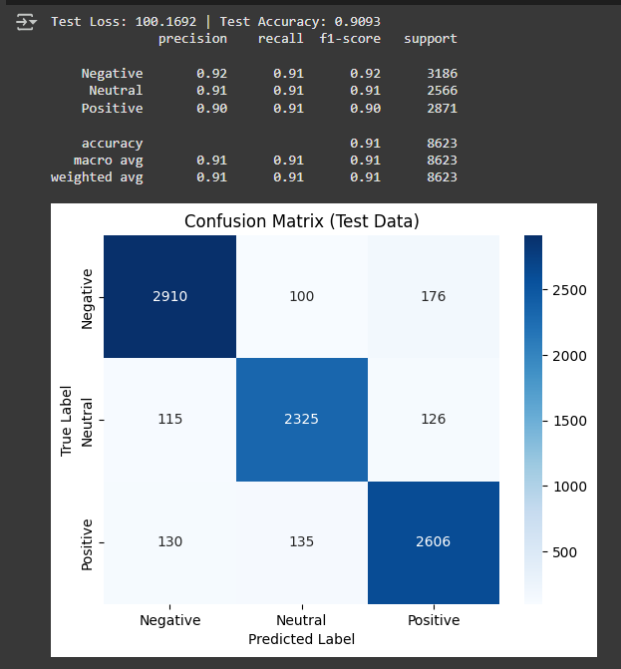
Distil BERT - BiLSTM:
ACCURACY OF TRAIN, VALDIATE AND TEST:
Train Accuracy – 98%
Validation Accuracy – 91%
Test Accuracy – 90%

Slide 13
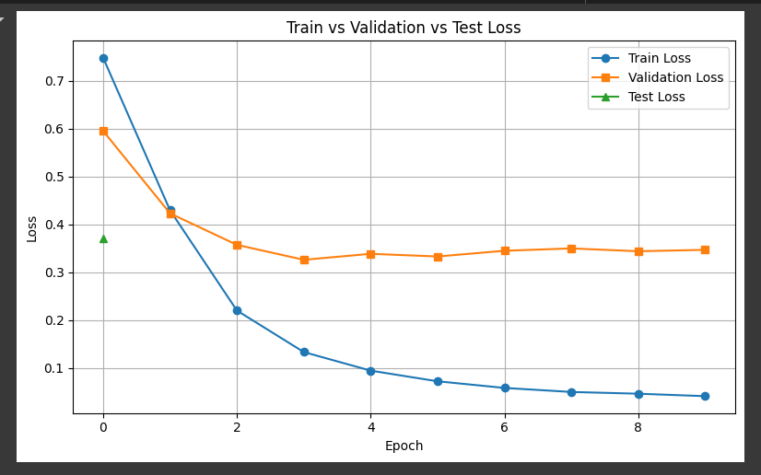
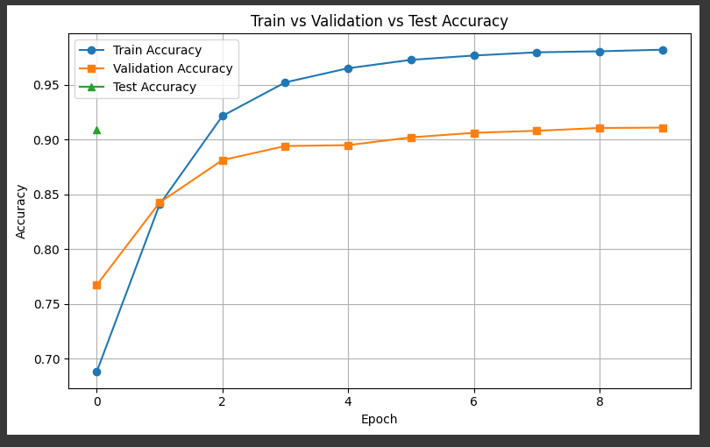
Distil- BiLSTM:
Visual representation of LOSS and ACCURACY of train, validation and test:

Slide 14
DistilBERT – BiLSTM:
Why its best model ?
Combines Pre-trained Semantics + Learning -Uses DistilBERT to extract contextual embeddings and BiLSTM to model sequence dependencies.
Strong on Both Short and Long Texts -Captures tweet-level semantics while maintaining memory of word order.
Generalizes Well to Noisy, Unseen Tweets - Fine-tuned embeddings and BiLSTM reduce overfitting on small data.
Lighter & Faster than Full BERT - 40% smaller and 60% faster than BERT, enabling faster training with fewer resources.
Improved Accuracy & Learning Efficiency - Outperformed SVM and RNN-BiLSTM in both accuracy and loss curves.
Zero Manual Feature Engineering - Tokenization + attention = automated understanding of language.

Slide 15
References:
Sentiment Analysis of Tweets using SVM Ahmad et al., 2017 – International Journal of Computer Applications.
Twitter Sentiment Analysis using RNN-BiLSTM International Journal of Creative Research Thoughts (IJCRT), 2022.
Transformers for Tweet Sentiment Classification International Research Journal of Engineering and Technology (IRJET), 2023

Slide 16
Future Scope:
RoBERTa with Self-Attention –
Transformer-only architecture with deep attention layers, no BiLSTM
Best for high-accuracy tasks, multilingual support, and deep understanding
Fully parallelizable transformer blocks
T5 / BART for Generative Sentiment Analysis –
Explainable Outputs: Instead of just "Positive", T5/BART can generate why the sentiment is positive.
Flexible Input/Output: Can be used for classification, translation, summarization, question answering — in one model.

Slide 17
